Slide 1

CHARACTER DEVICE DRIVER
BLOCK DEVICE DRIVER
NETWORK DEVICE DRIVER

Slide 2

CHARACTER DEVICE DRIVER
-are responsible for managing devices that handle data as a stream of bytes, typically in a sequential manner. They are designed for devices that transfer relatively small amounts of data and do not require random access.

Slide 3


CHARACTERISTICS:
SEQUENTIAL ACCESS
-Data is accessed in a linear fashion, one byte at a time.
LIMITED DATA VOLUME:
Typically used for devices with low data transfer rates
www.reallygreatsite.com

Slide 4

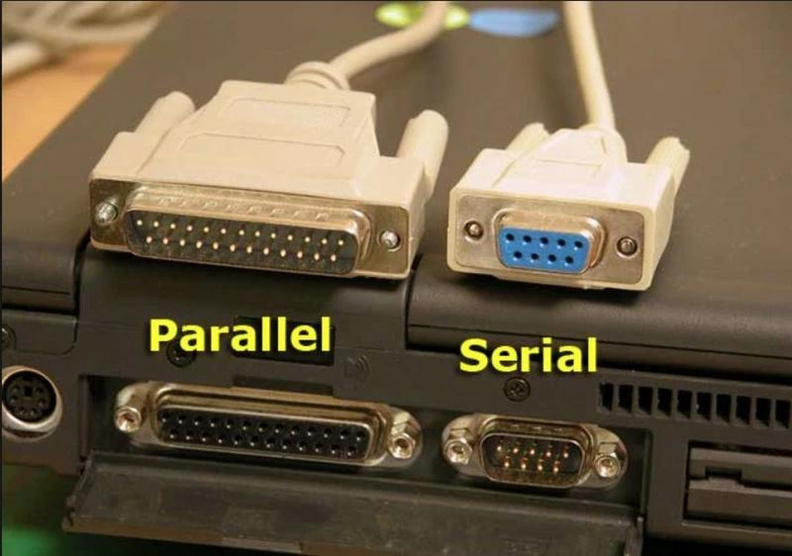
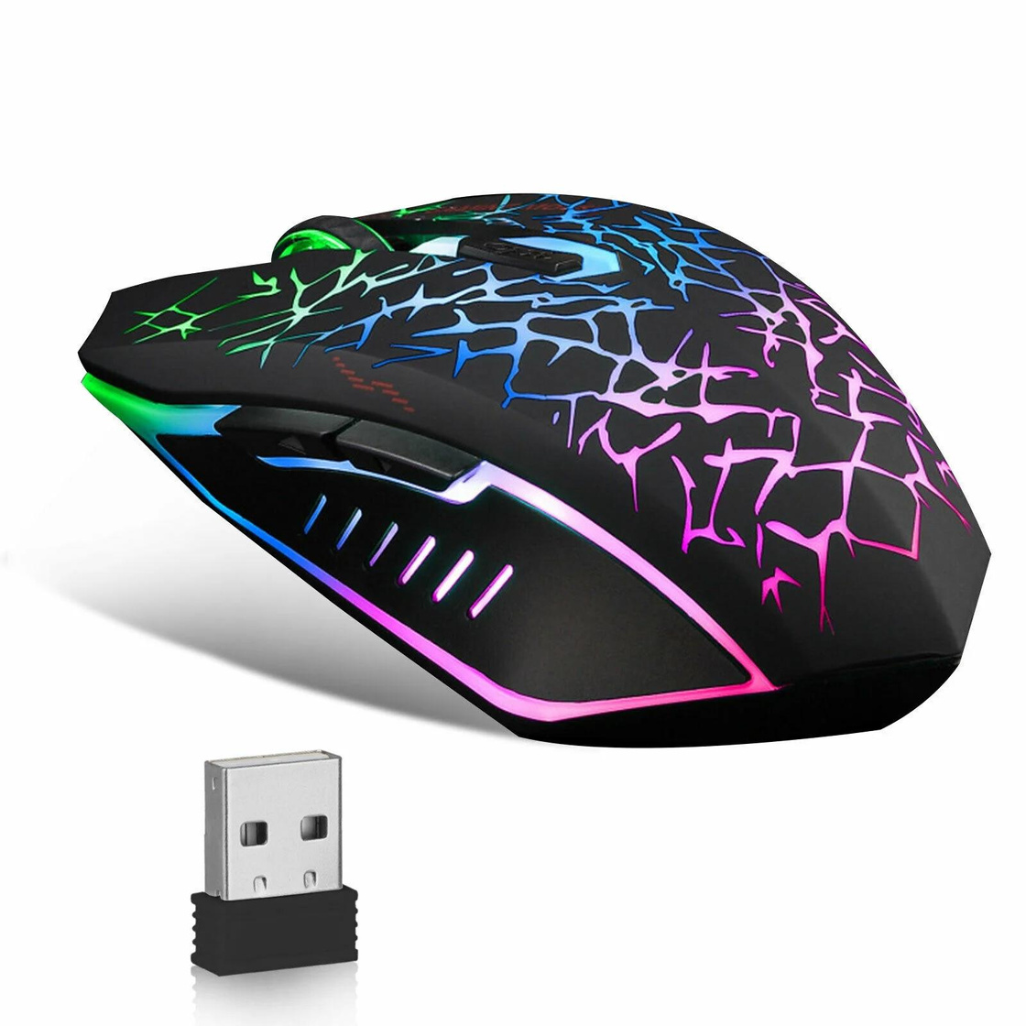
Examples
mouse

Slide 5
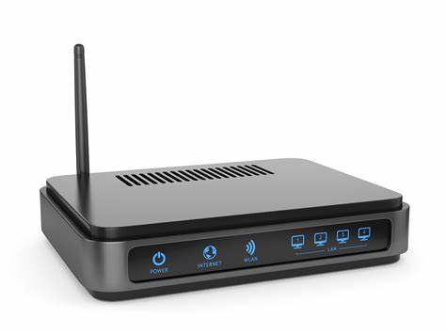
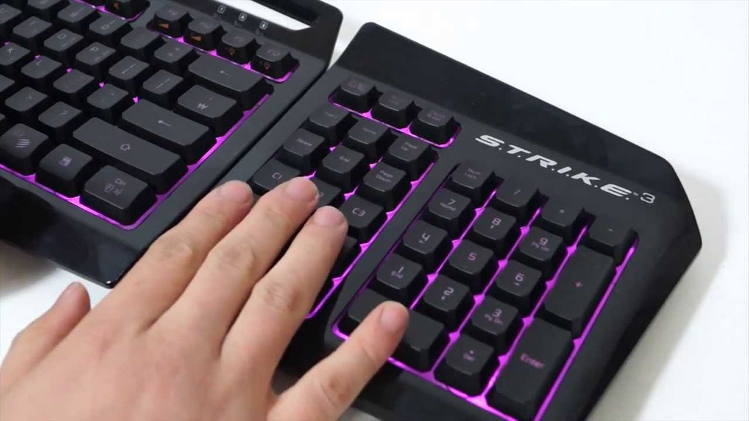
Examples
keyboard
modem

Slide 6


FUNCTIONALITY:
I/O CONTROL (IOCTL)
MEMORY MAPPING
READ AND WRITE OPERATIONS
-Character device drivers handle system calls like read() and write() to transfer data between the user space and the device.
-They can provide additional interfaces for device-specific commands, such as configuring device settings.
Some character devices, like frame buffers, support memory mapping using the mmap() system call, allowing direct access to device memory by applications
06

Slide 7

BLOCK DEVICE DRIVERS
-Manage devices that store data in fixed-size blocks, allowing for random access to any specific block. These drivers are optimized for high-speed data transfer and are commonly used for devices with large data volumes.

Slide 8
CHARACTERISTICS:
RANDOM ACCESS:
Data can be accessed in any order, regardless of its position on the device.
LARGE DATA VOLUME:
Typically used for devices with high data transfer rates.

Slide 9
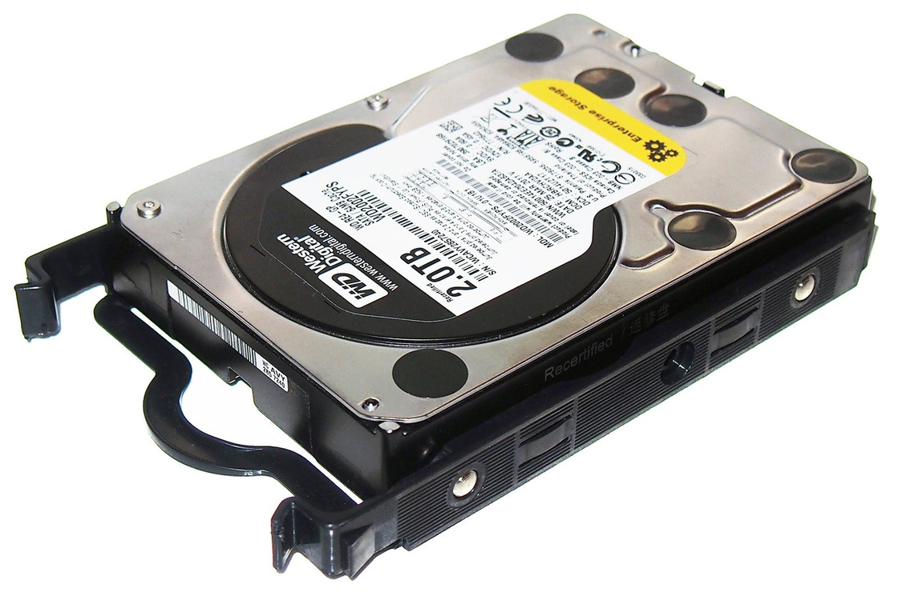
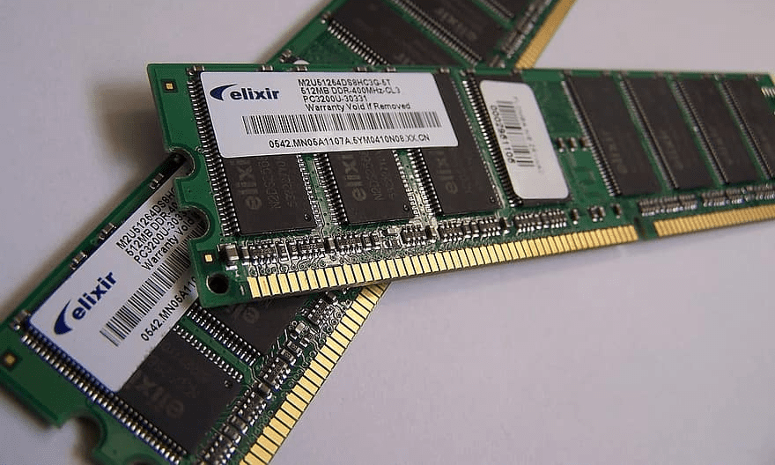
Examples
hard drIve
ram

Slide 10
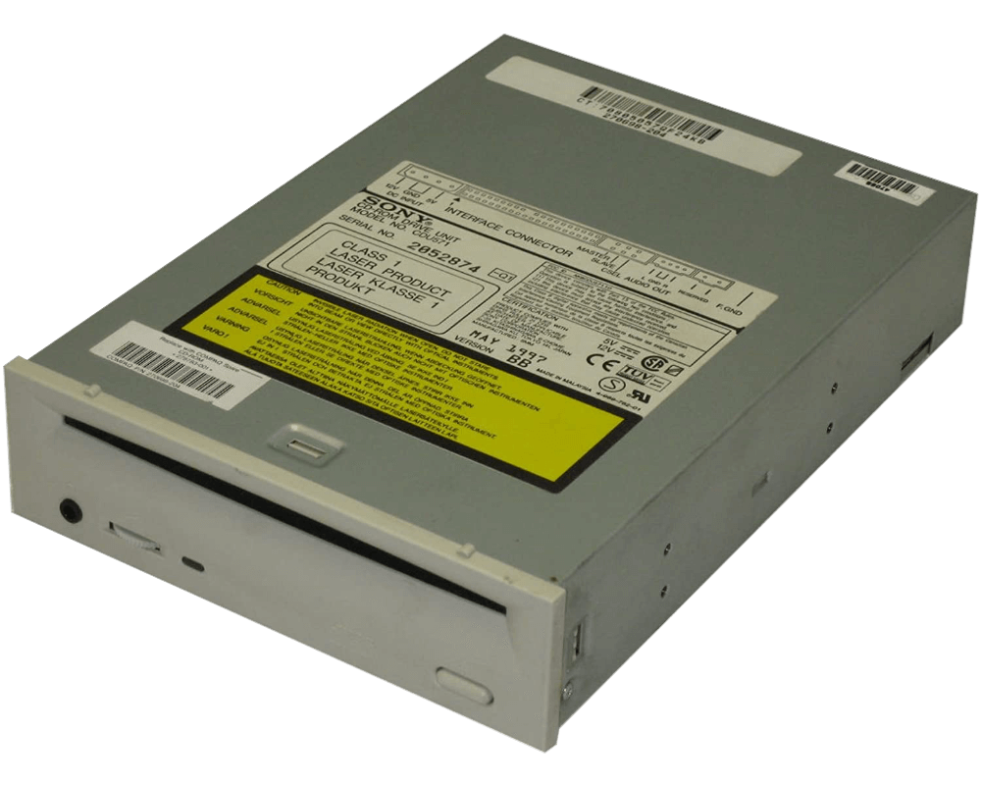
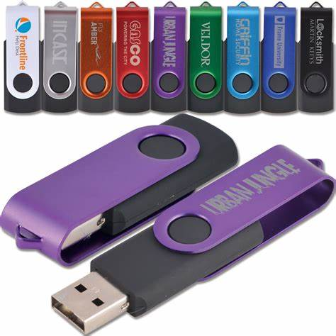
Examples
cd-rom
flashdrIVE

Slide 11
FUNCTIONALITY:
BLOCK I/O SUBSYSTEM:
REQUEST() FUNCTION:
BUFFER CACHE:
The Linux kernel provides a specialized block I/O subsystem to manage block devices efficiently.
Block device drivers implement a request() function that handles both read and write operations.
The buffer cache is used to store recently accessed data, improving performance by reducing the need for physical disk access
06

Slide 12
NETWORK DEVICE DRIVERS
-Are responsible for managing network interface cards (NICs) and facilitating communication between the computer and the network. They handle the transmission and reception of data packets, translating between the operating system's generic networking commands and the specific commands required by the NIC.

Slide 13
Examples
- Ethernet drivers
- Wi-Fi drivers
- Bluetooth drivers

Slide 14
FUNCTIONALITY:
INTERRUPT HANDLING:
TRANSMISSION AND RECEPTION:
QUEUE MANAGEMENT:
Network drivers handle interrupts generated by the NIC, indicating the arrival of data packets.
They manage the transmission of data packets from the computer to the network and the reception of packets from the network to the computer.
Network drivers manage queues for incoming and outgoing data packets, ensuring efficient data flow.
06

Slide 15




group 1
WILSON NAVAREZ
JOVILYN MIE RADA
JOHN KENNETH ABLAO
CRISTIAN MARK CATILOC
VEMARK MONDICO

Slide 16


THANK YOU!

